Slide 1

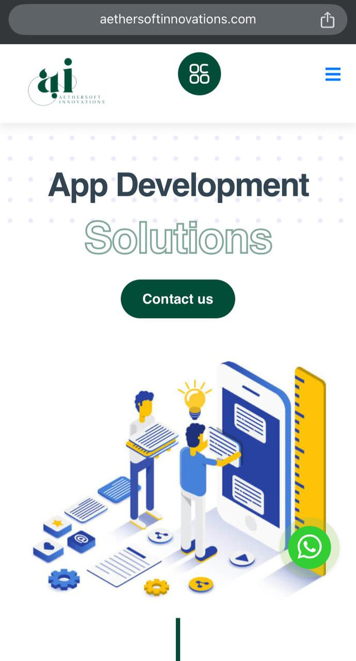







01
AetherSoft
Innovations
Innovation Beyond Limits.
+92 335 7758256
Incubatted at IU Core, IU EDC Campus
info@aethersoftinnovations.com
www.aethersoftinnovations.com

Slide 2


Problem & Solutions
Many businesses face digital presence issues, high costs, and ineffective marketing. Challenges like scalability, SEO, and lead generation slow growth, while delays and lack of customization add to the struggle.
Problems
Sollutions
  Limited Digital Transformation – Many businesses lack the technical expertise to establish a strong digital presence.
  High Development Costs – Quality web and app development is expensive, making it inaccessible for startups and SMEs.
  Poor Online Visibility – Businesses struggle with ineffective SEO and digital marketing, leading to low customer engagement.
  End-to-End Digital Solutions – AetherSoft provides expert web development, app development, and digital marketing to establish a strong online presence.
  Affordable & Scalable Services – Cost-effective packages tailored for startups and SMEs, ensuring high-quality digital solutions within budget.
  SEO & Targeted Marketing – Data-driven SEO and digital campaigns to improve visibility, engagement, and lead generation.

Slide 3
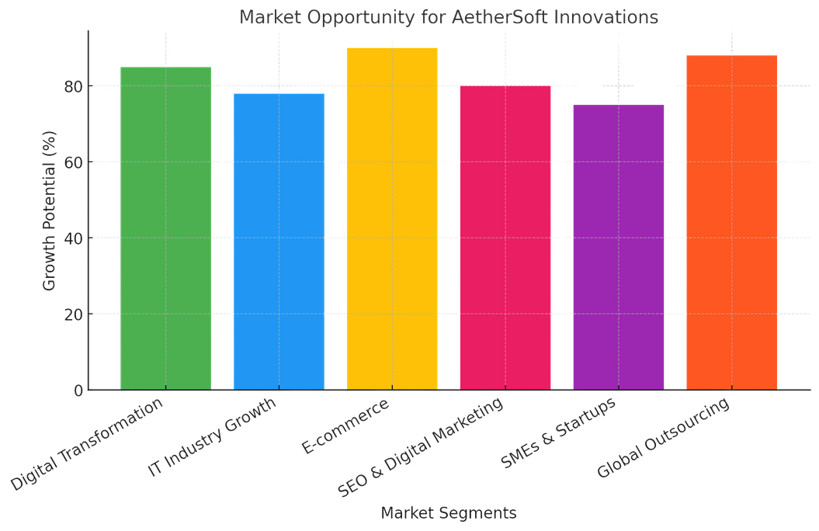

Market Opportunity
The Size and Scope of the Market
15%
Potential Growth
The market presents a significant opportunity, driven by the increasing demand for innovative and scalable digital solutions. As businesses increasingly adopt technology to stay competitive, the potential for growth in the digital services sector is substantial. With an expanding market, particularly in emerging regions like Pakistan, the industry is expected to see a growth rate of approximately 15-20% annually, as businesses look for cost-effective, quality-driven solutions to meet their evolving needs.

Slide 4


Business Model
Our business model offers project-based, retainer, and subscription services, focusing on web development, app creation, SEO, and digital marketing. We target SMEs and startups, providing tailored solutions with a customer-focused approach, building long-term relationships and consistent revenue through ongoing support and performance-based pricing
Pricing Model
Revenue Streams
Income Strategies
Hourly Billing: Rates range from PKR 2,000 - 7,000/hr based on experience.
Project-Based: Websites start at PKR 50,000, mobile apps from PKR 300,000.
Retainers: SEO/Social Media services range from PKR 25,000 - 50,000/month.
Subscriptions: Hosting/CRM services cost PKR 5,000 - 50,000/month.
One-time Project Fees: Income from clients who pay for a specific service or deliverable.
Recurring Revenue: Income from ongoing services such as monthly retainers, subscriptions, and maintenance contracts.
Project-Based: Charge for one-time services like web or app development.
Retainers: Secure ongoing monthly contracts for services like SEO or digital marketing.
Subscriptions: Offer recurring services like hosting or maintenance.
Commissions: Earn from sales or leads generated through campaigns.

Slide 5


Systems Limited
Services Offered: Software development, digital transformation, SaaS products, cloud solutions, IT consulting.
Competitive Analysis
Opportunity for AetherSoft Innovations: Position your agency as a more affordable and tailored option for SMEs and startups, offering personalized customer service with scalable solutions..
NetSol Technologies
Services Offered: Custom software solutions, SaaS products for leasing and finance sectors, IT consulting.
Opportunity for AetherSoft Innovations: Broaden the service portfolio beyond niche industries, emphasizing versatility and adaptability to different sectors like retail, healthcare, etc.
The Size and Scope of the Market
Abacus Consulting
The market for AetherSoft Innovations, which offers web development, graphic design, SEO, digital marketing, app development, and SaaS products, is expanding rapidly. The global IT services market is valued at over $1 trillion, with Pakistan’s IT sector expected to exceed $5 billion by 2025. The SaaS market, growing at a compound annual growth rate (CAGR) of 18%, offers significant opportunities. Locally, SMEs and startups are increasingly adopting digital solutions, while internationally, demand for outsourcing IT services and SaaS products is rising. AetherSoft Innovations is well-positioned to leverage these trends and capture market share both in Pakistan and internationally.
Services Offered: Software development, business process outsourcing, digital transformation, cloud services.
Opportunity for AetherSoft Innovations: Emphasize your focus on innovation, especially in SaaS, web development, and app development. You can also leverage your agility and flexibility to serve small to medium-sized businesses.
United Sol
Services Offered: IT consulting, web development, SaaS products (e.g., OnTrack for delivery management), mobile app development.
Opportunity for AetherSoft Innovations: Offer a broader range of SaaS products, with the flexibility to adapt to multiple industries. Focus on personalized customer service and affordable pricing for small to medium-sized businesses.

Slide 6


Market Strategy
Target Market:
SMEs and Startups: Focus on providing affordable, scalable, and high-quality digital solutions to small and medium-sized enterprises and startups in Pakistan and beyond.
International Markets: Expand outreach to the MENA region, South Asia, and Western markets where outsourcing is on the rise.
Digital Marketing Strategy
Social Media Marketing: Use platforms like LinkedIn, Facebook, Instagram, and Twitter to build a strong online presence. Share case studies, testimonials, and behind-the-scenes content.
Paid Advertising: Run targeted PPC campaigns on Google Ads and social media platforms to reach specific industries and potential clients looking for digital solutions.
Sales Strategy
Lead Generation: Focus on inbound marketing tactics such as SEO, content marketing, and social media to attract and nurture leads.

Slide 7


2025
Thank You So Much
+92 335 7758256
Incubatted at IU Core, IU EDC Campus
info@aethersoftinnovations.com
www.aethersoftinnovations.com

